Slide 1
Capstone Project 2: RNN Portfolio Analysis
Milestone Report by Joseph Javier

Slide 2
Motivation and Problem Statement
This project would implement a RNN that will model, observe, and forecast stock/exchange-traded funds (ETFs) data to determine the best stocks for portfolio growth. This would be relevant for investors, portfolio managers, financial/investment planners, and hedge/endowments to name a few. A few stocks will be selected for implementation and their collective performance will be observed.
My intended client would be any individual or institution concerned with investments. These entities would use my analysis and results for normal operations but also more importantly, for determining critical areas/weaknesses in a given timeframe should an unfortunate economic disaster occur such as the COVID-19 and Great Recessions. My project would serve as a reference and basis for implementing guidance, standard operating procedures, and investment education for the public.

Slide 3
Methodology and Approach
After downloading CSV data on some stocks of interest, I will clean, perform EDA, and split the data into a 70/30 training/test set.
Then, I predict the performance of buy-hold and buy signal strategies by implementing and training an RNN, more specifically a LSTM, over time.
This LSTM is later tested to predict how well a portfolio may perform over a specified timeframe.
The results are visualized through Matplotlib and Seaborn using time series plots and of course statistical EDA plots ensuring data/model validity.

Slide 4
Data Wrangling Steps
Obtained source daily data (as CSV files from the Yahoo finance website) for the following stocks/ETFs to observe investment potential: AAPL, AMZN, DIA, FB, MSFT, NFLX, SPY, TSLA, TWTR, and XOM.
Used “describe” and “info” DataFrame methods to determine data validity and integrity for all downloaded CSV files. If a null value were present, the SimpleImputer function that uses the mean of the previous and following data points would be used to impute it.
Created time series plots to observe price behavior over time.
Looked for outliers as “anomalies” or deviations from the general trend of the data. These were sought by plotting upper and lower yearly rolling bounds that are four standard deviations away from the yearly moving average. If a data point exceeds these bounds, then an outlier is found.

Slide 5
Data Storytelling
For this section, stock source data are analyzed to answer the following questions below. Numerous plots were generated and can be viewed in this GitHub repo link to the Jupyter Notebook containing the analysis.
How well are selected popular stocks and ETFs currently performing since their Initial Public Offering (IPO)?
Are there any correlations or covariances in pricing between the selected stocks and ETFs?

Slide 6
How well are selected popular stocks and ETFs currently performing since their Initial Public Offering (IPO)?
From plotting the source data, nearly all stocks/ETFs (i.e. TWTR being the exception) are performing well since their IPO. In other words, for a specified stock/ETF, if the final Adjusted Closing price is greater than the starting Adjusted Closing price, it should be considered as a potential investment opportunity. Some of them were unfortunately affected by market corrections such as the Great and COVID-19 Recessions (and even recovered over time), but the others continued to perform positively uninfluenced.

Slide 7
Are there any correlations or covariances in pricing between the selected stocks and ETFs?
Yes, most notably between any pairings of AAPL, AMZN, FB, MSFT, NFLX, DIA, and SPY. Any unique pairing will result in a high Pearson Adjusted Closing price correlation ranging anywhere from 0.87-0.99 and a high log covariance ranging anywhere from 7.1-13.0 as shown visually in the next section. Since all prices (i.e. High, Low, Open, Close, Adjusted Close), follow nearly identical shape and trend, we can safely assume that these correlations and covariances hold for all prices.

Slide 8
Statistical Data Analysis
For this analysis, Time Series EDA was performed and heatmaps of correlation and covariance were made.
These were performed on Adjusted Closing price data and, as alluded previously, we can safely assume that these results will be very similar for all prices since they follow nearly identical shape and trend.

Slide 9
Step 1: Conduct Time Series EDA
Create plots visualizing Density, Seasonality, Trend, and Noise for each stock/ETF to characterize the data as time series. Visualizations can be viewed in the corresponding Jupyter notebook.
Results and Findings:
Density: Here we see that five of them (AAPL, AMZN, MSFT, NFLX, and XOM) were priced closed to zero most of the time possibly due to the market not being familiar with them at first. The other five (TWTR, FB, TSLA, SPY, and DIA) already had popularity prior to their IPOs and caused price movement in the beginning. One minor caveat is for DIA, SPY, MSFT, and XOM, whose Close and Adjusted Close plots are different due to corporate actions and dividends.
Seasonality: By plotting the source data as done previously, we can suspect that there are no discernable patterns or cycles in any of the stocks/ETFs. These seasonality plots show straight horizontal lines at y = 0 which confirm this suspicion.
Trend and Noise: The source data was plotted alongside its yearly simple moving average to determine the general trend and focus less on the noise/fluctuations. We see that any of them either trend positive, negatively, or neither. Some even trend linearly or parabolically.

Slide 10
Step 2: Correlation and Covariance Analysis
Calculate Pearson correlation coefficients and covariances between stocks and ETFs (confirm if relationships are present between any stocks/ETFs).
Results and Findings: As stated in the Data Storytelling section, the Pearson Adjusted Closing price correlation coefficients and covariances of the all stocks/ETFs are shown in Figures 1 and 2 (next two slides), respectively.

Slide 11
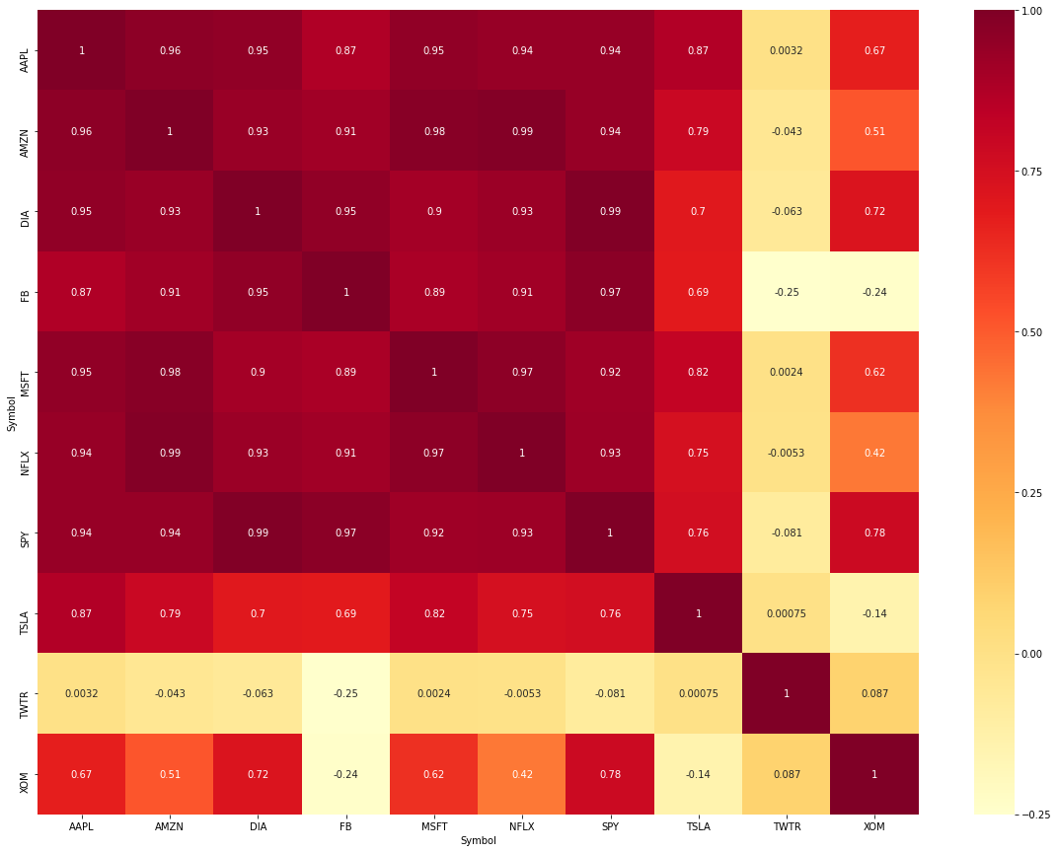
Figure 1. Correlation Coefficient Heatmap
Here in Figure 1, we see the strongest positive correlations shown by the dark red/maroon boxes meaning any pairing made from AAPL, AMZN, FB, MSFT, NFLX, DIA, and SPY. These make sense since:
These stocks are the top technology companies that have significant influence over the U.S. economy, and
These two ETFs are overall indicators of economic health and these technology companies are listed in these ETFs. Thus, for a simple buy-and-hold portfolio, investing in any or all of them should be considered.
On the other hand, we also see that correlations with TSLA, TWTR, and XOM range from moderately positive to essentially non-existent, but these stocks may be considered under different investing strategies.

Slide 12
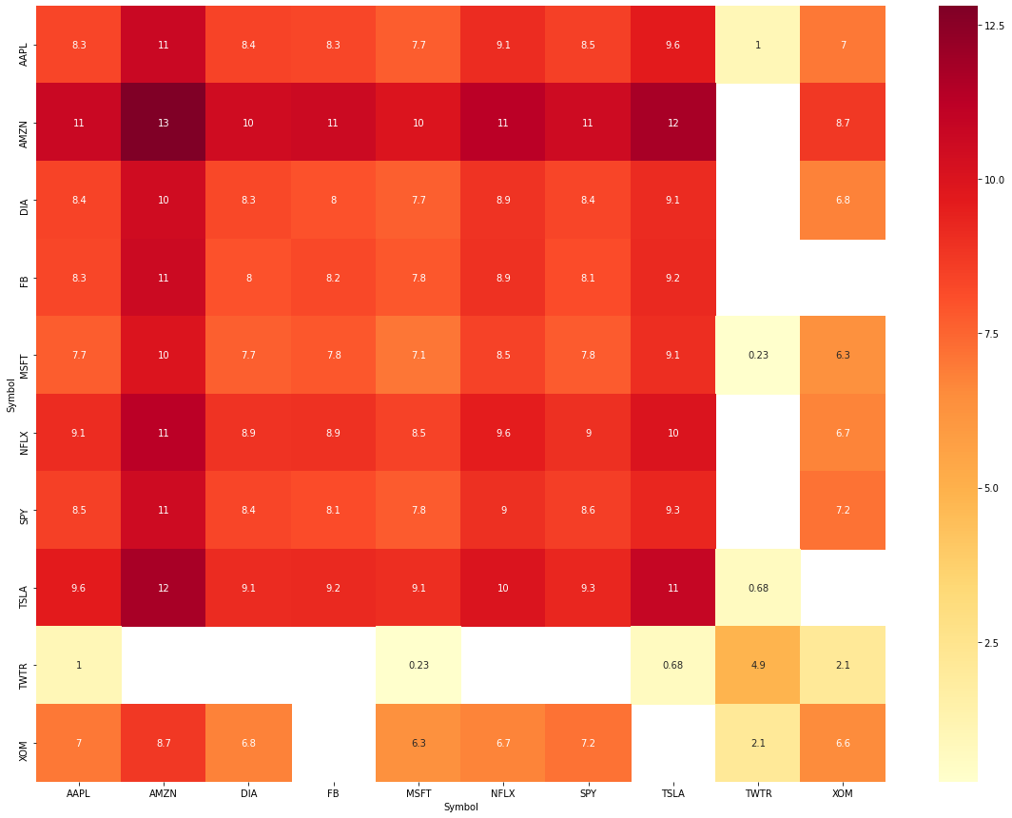
Figure 2. Covariance Heatmap
For Figure 2, the covariance data was logarithmically transformed for clarity since this properly highlights strong positive covariance and reinforces the strong relationships between pairings of the stocks/ETFs discussed previously. Using a linear scale would produce a misleading and confusing visualization.

Slide 13

RNN Usage and In-Depth Analysis to come next…

